Slide 1
32. gün
26/10/2025

Slide 2
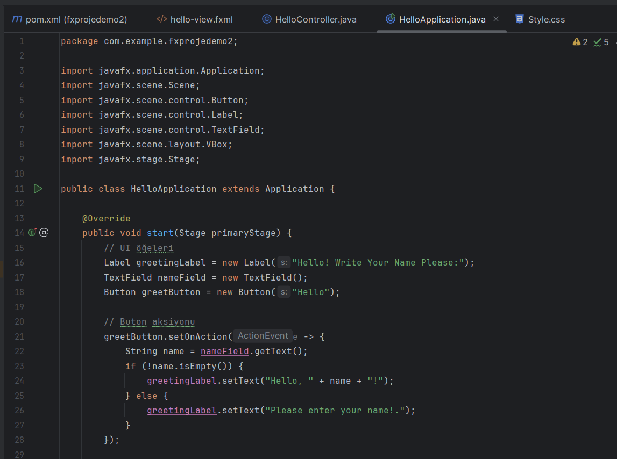
An App for Greetings:

Slide 3
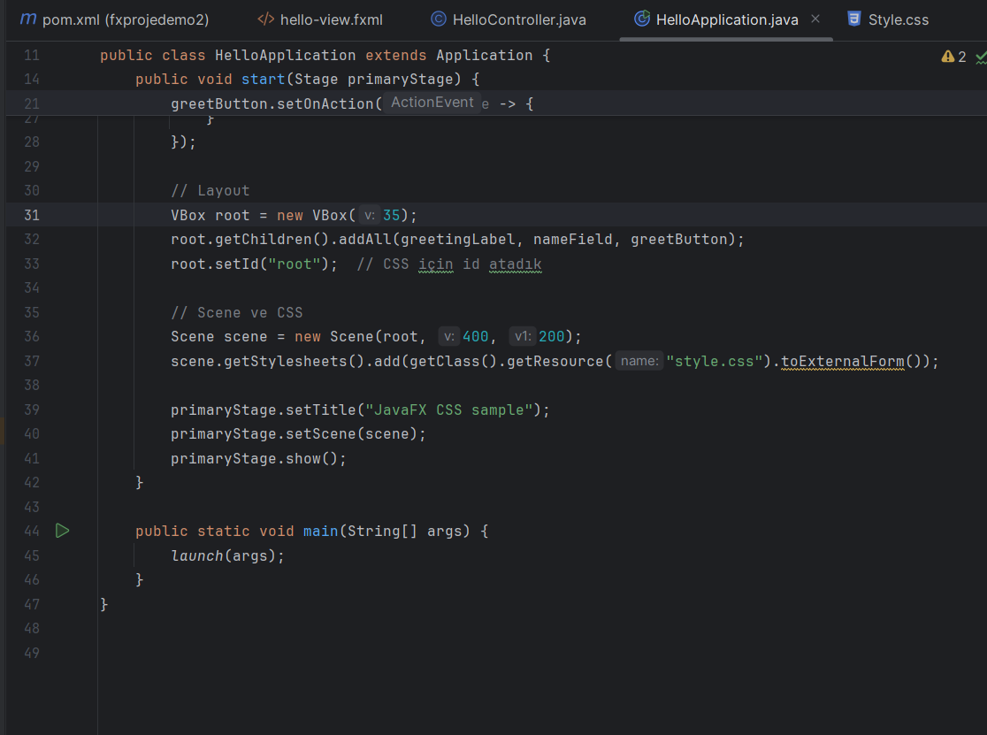

Slide 4
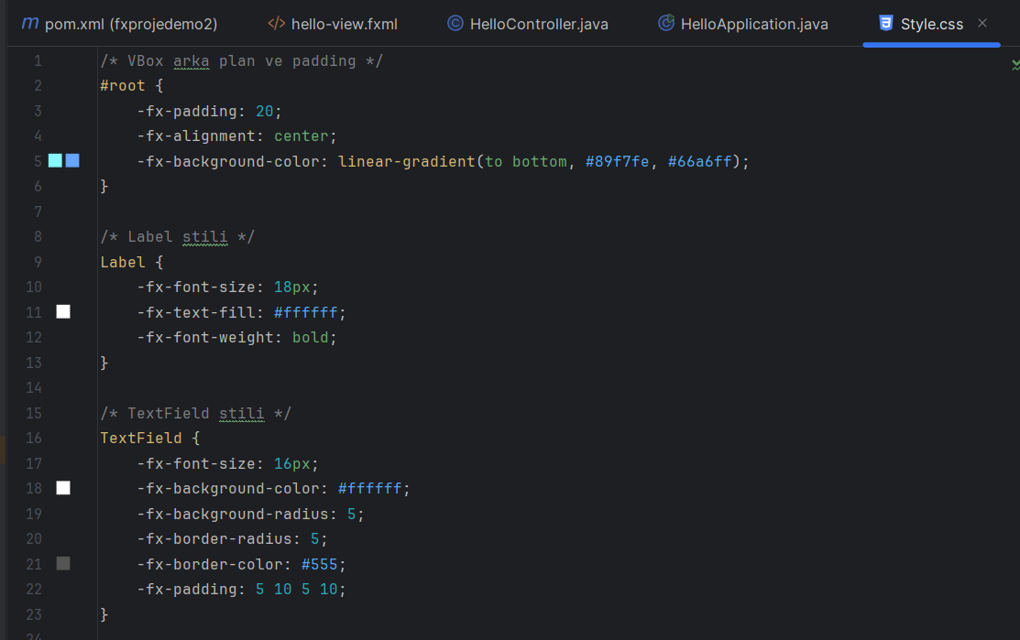

Slide 5
